Slide 2

Basic definition
$\int_{a}^{b}{f\left(x\right)}dx=\lim_{n→∞}{\sum_{k=1}^{n}{f\left(x_{k}\right)}}∆x=\lim_{n→∞}{\sum_{k=1}^{n}{\frac{(b−a)}{n}f(a+(b−a)\frac{k}{n}}})$
$∆x = \frac{b−a}{N},$
$x_{k}=∆x∙k+a$
$\int_{0}^{1}{f\left(x\right)}dx=\lim_{n→∞}{\sum_{i=1}^{n}{f\left(x_{i}\right)}}∆x= \lim_{n→∞}{\sum_{k=1}^{n}{\frac{1}{n}f(\frac{k}{n}}})=\lim_{n→∞}{\sum_{k=1}^{n}{\frac{1}{n}f(1−\frac{k}{n}}})$
$∆x = \frac{1}{N},$
$x_{k}=∆x∙k$

Slide 3
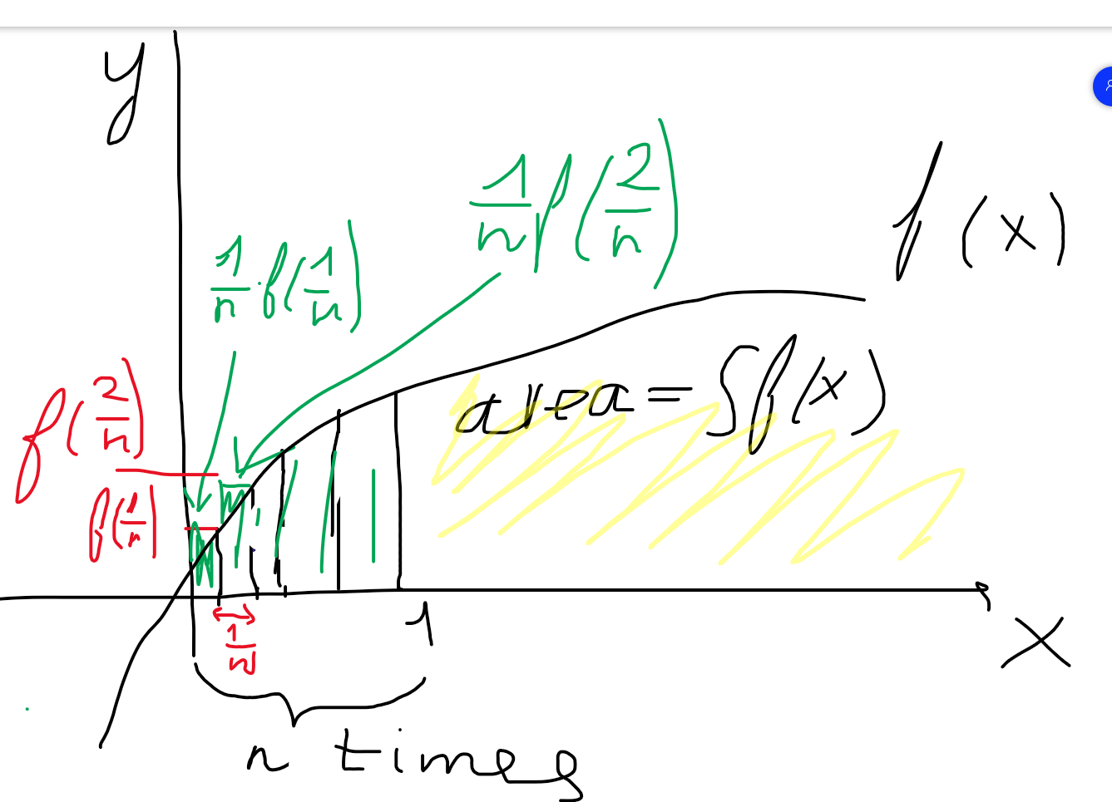
Calculate integral with rechtangles

Slide 4
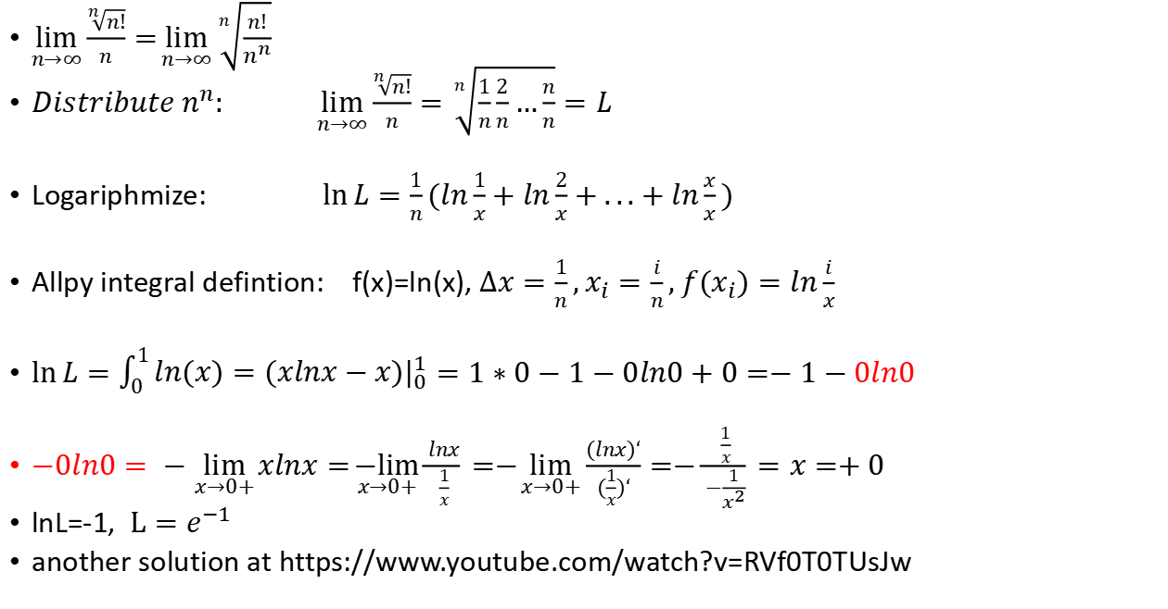
Base intergral definition usage:
$\lim_{n→∞}{\frac{\sqrt[n]{n!}}{n}}=\lim_{n→∞}{\sqrt[n]{\frac{n!}{n^{n}}}}$
$Distribute n^{n}: \lim_{n→∞}{\frac{\sqrt[n]{n!}}{n}}=\sqrt[n]{\frac{1}{n}\frac{2}{n}…\frac{n}{n}}=L$
Logariphmize: $\ln{L=\frac{1}{n}}(ln\frac{1}{x}+ln\frac{2}{x}+...+ln\frac{x}{x})$
Allpy integral defintion: f(x)=ln(x), $∆x=\frac{1}{n},x_{i}=\frac{i}{n}, f(x_{i})=ln\frac{i}{x}$
$\ln{L=\int_{0}^{1}{ln(x)=(xlnx−x)|_{0}^{1}}=1∗0−1−0ln0+0=−1−0ln0}$
$−0ln0= −\lim_{x→0+}{xlnx=\underset{x→0+}{−lim}{\frac{lnx}{\frac{1}{x}}}}=−\lim_{x→0+}{\frac{(lnx)‘}{(\frac{1}{x})‘}}=−\frac{\frac{1}{x}}{−\frac{1}{x^{2}}}=x=+0$
lnL=-1, $L=e^{−1}$
another solution at https://www.youtube.com/watch?v=RVf0T0TUsJw

Slide 5
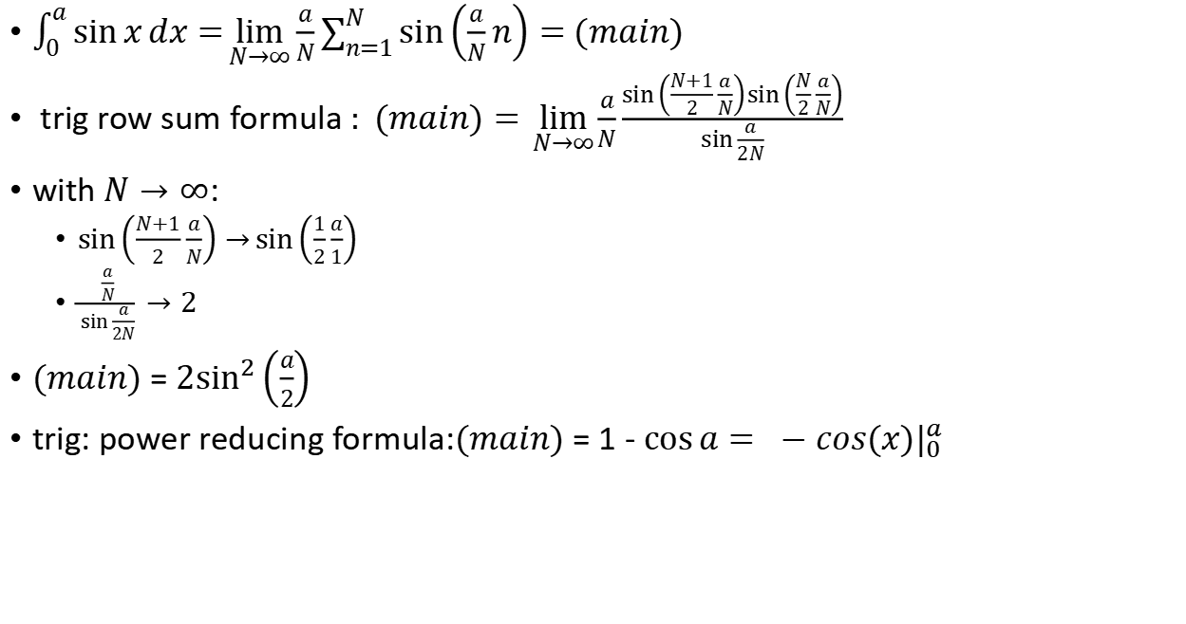
Basic definition examples
$\int_{0}^{a}{\sin{x}dx}=\lim_{N→∞}{\frac{a}{N}\sum_{n=1}^{N}{\sin\left(\frac{a}{N}n\right)=}}$ $(main)$
trig row sum formula $: (main)=\lim_{N→∞}{\frac{a}{N}}\frac{\sin\left(\frac{N+1}{2}\frac{a}{N}\right)\sin\left(\frac{N}{2}\frac{a}{N}\right)}{\sin{\frac{a}{2N}}}$
with $N→∞$:
$\sin\left(\frac{N+1}{2}\frac{a}{N}\right)→\sin\left(\frac{1}{2}\frac{a}{1}\right)$
$\frac{\frac{a}{N}}{\sin{\frac{a}{2N}}}→2$
$(main)$ = ${2sin}^{2}\left(\frac{a}{2}\right)$
trig: power reducing formula:$(main)$ = 1 - $\cos{a}= −cos(x)|_{0}^{a}$

Slide 6
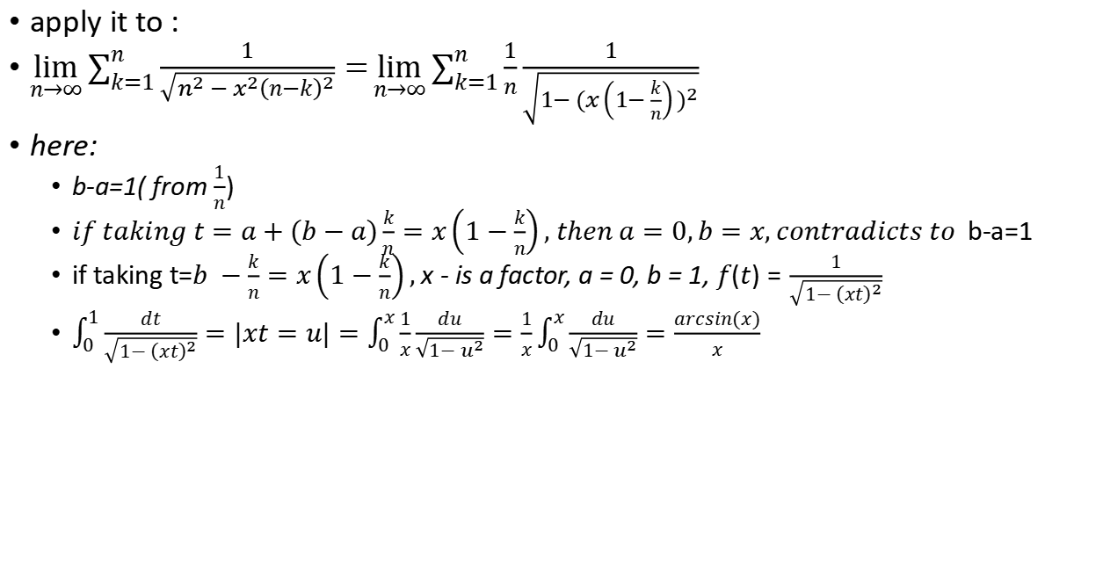
Basic integral definition usage:
apply it to :
$\lim_{n→∞}{\sum_{k=1}^{n}{\frac{1}{\sqrt{n^{2}−x^{2}{\left(n−k\right)}^{2}}}}}=\lim_{n→∞}{\sum_{k=1}^{n}{\frac{1}{n}\frac{1}{\sqrt{1−{(x\left(1−\frac{k}{n}\right))}^{2}}}}}$
here:
b-a=1( from $\frac{1}{n}$)
$if taking t=a+(b−a)\frac{k}{n}=x\left(1−\frac{k}{n}\right), then a=0,b=x, contradicts to$b-a=1
if taking t=$b −\frac{k}{n}=x\left(1−\frac{k}{n}\right),$ x - is a factor, a = 0, b = 1, $f(t)=\frac{1}{\sqrt{1−{\left(xt\right)}^{2}}}$
$\int_{0}^{1}{\frac{dt}{\sqrt{1−{\left(xt\right)}^{2}}}}=|xt=u|=\int_{0}^{x}{\frac{1}{x}\frac{du}{\sqrt{1−u^{2}}}}=\frac{1}{x}\int_{0}^{x}{\frac{du}{\sqrt{1−u^{2}}}}=\frac{arcsin(x)}{x}$

Slide 7
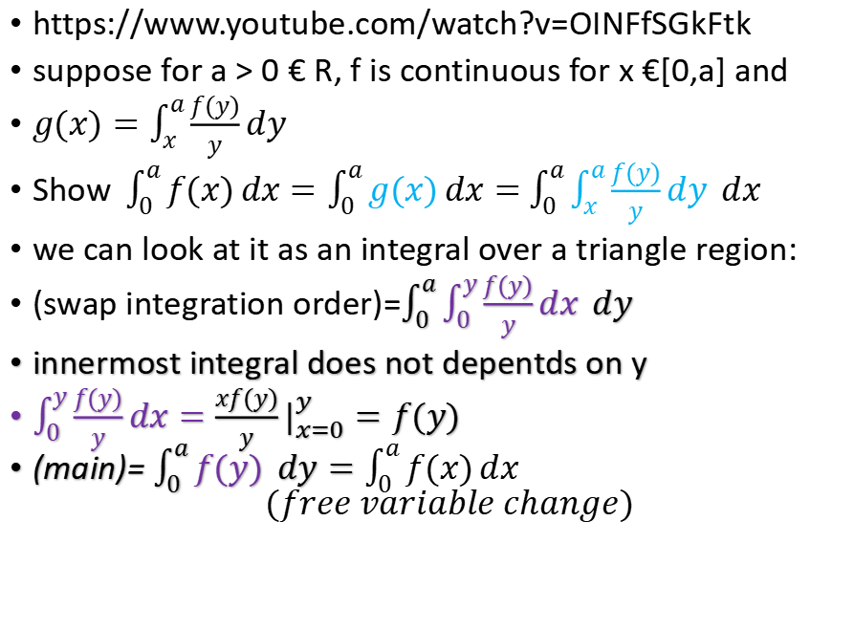
A very friendly integral problem!
https://www.youtube.com/watch?v=OINFfSGkFtk
suppose for a > 0 € R, f is continuous for x €[0,a] and
$g(x)=\int_{x}^{a}{\frac{f(y)}{y}}dy$
Show$\int_{0}^{a}{f(x)}dx=\int_{0}^{a}{g(x)}dx=$ $\int_{0}^{a}{\int_{x}^{a}{\frac{f(y)}{y}}dy }dx$
we can look at it as an integral over a triangle region:
(swap integration order)=$\int_{0}^{a}{\int_{0}^{y}{\frac{f(y)}{y}}dx }dy$
innermost integral does not depentds on y
$\int_{0}^{y}{\frac{f(y)}{y}}dx={\frac{xf(y)}{y}|}_{x=0}^{y}=f(y)$
(main)= $\int_{0}^{a}{f(y) }dy=\int_{0}^{a}{f(x)}dx$ $$(free variable change)$$

